Slide 1
Airbnb house price prediction
From :
Surya Narayana Reddy Chintacunta

Slide 2
Description of the project and problem statement
The aim of this data science project is to predict the price of Airbnb listings in Newyork based on various features that are available in the dataset.
With the increasing popularity of Airbnb, property owners are constantly looking for ways to maximize their earnings by setting competitive prices for their properties.
The primary problem statement of this project is to develop a model that can accurately predict the price of Airbnb listings.
The model should take into account various factors that influence the price, including the location of the listing, the type of property, the number of bedrooms and bathrooms, the amenities provided, and more.
The model should be able to handle missing data and outliers, and it should be trained on a large dataset to ensure that it can accurately predict the price of new listings.

Slide 3

Implemented solution description
The main motive of the project is to predict the Airbnb listing prices. Hence "Price" is the unit for my analysis. .
Implemented the first phase which is Data preprocessing and EDA using Matplotlib, Seaborn, and Plotly for visualizations.
Used Data Preprocessing,
Handling missing values and
Encoding the data for the project.
Used Logistic Regression, Decision Tree and Random Forest and Ridge regressor machine learning models to predict the “Price”based on input features.

Slide 4
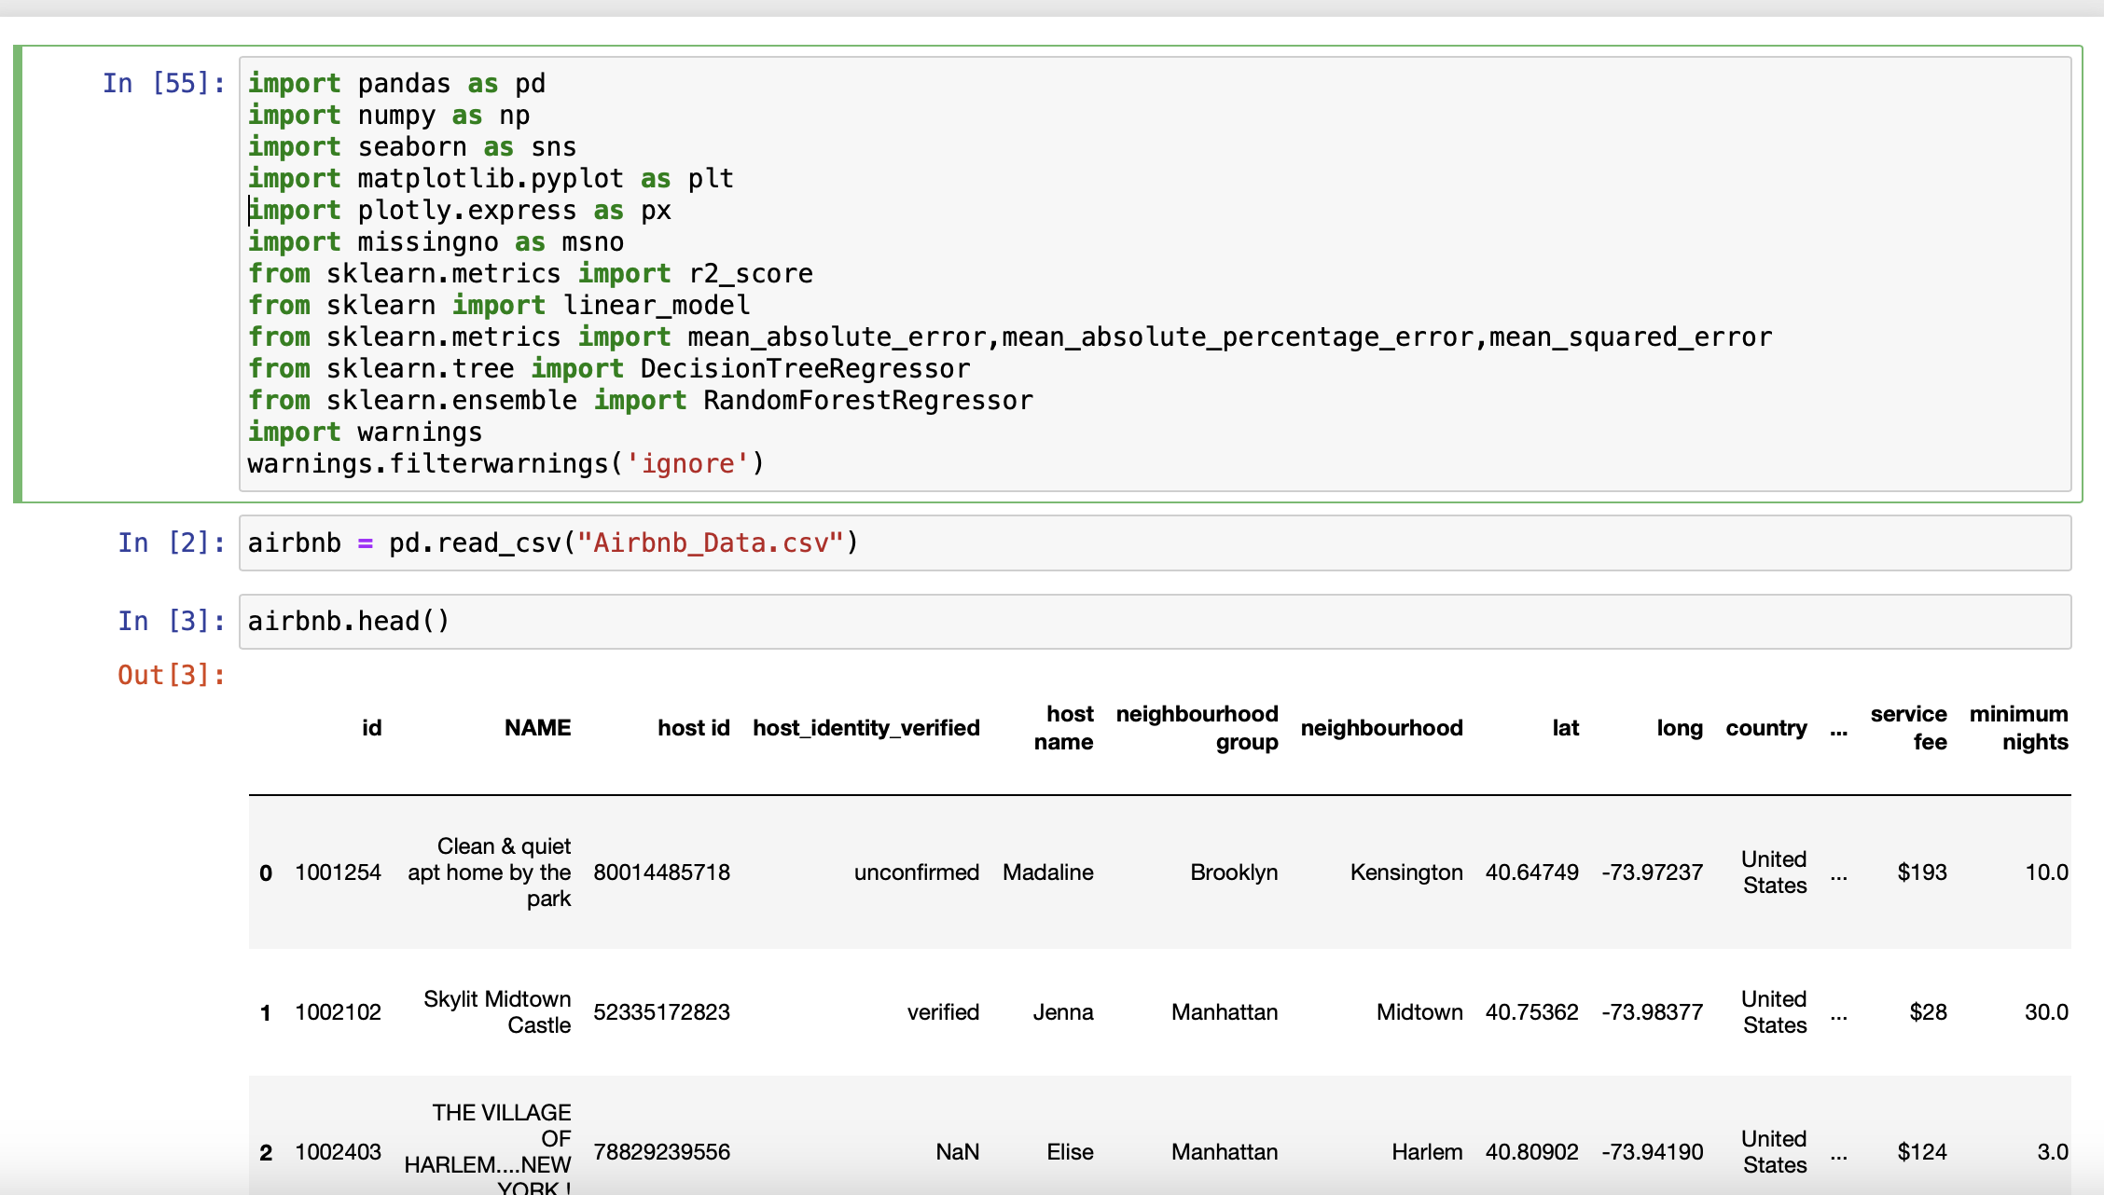
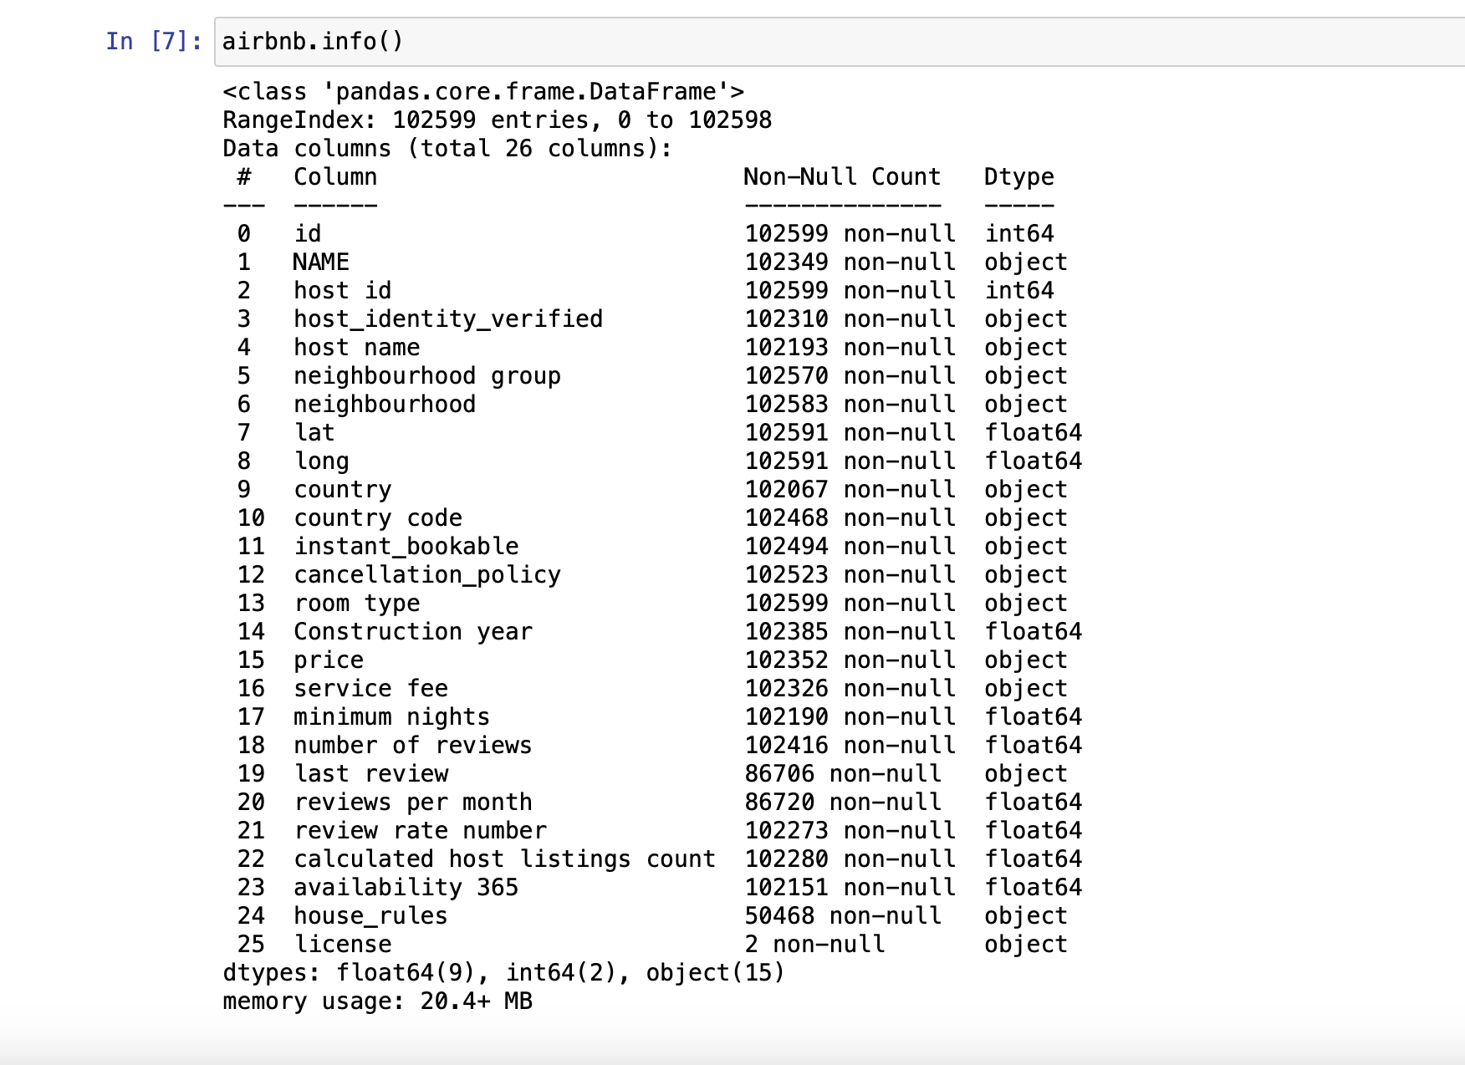
This Image illustrates all the features in the dataset with their data types.
The Above image shows, Importing all the necessary libraries and loading the data successfully.

Slide 5
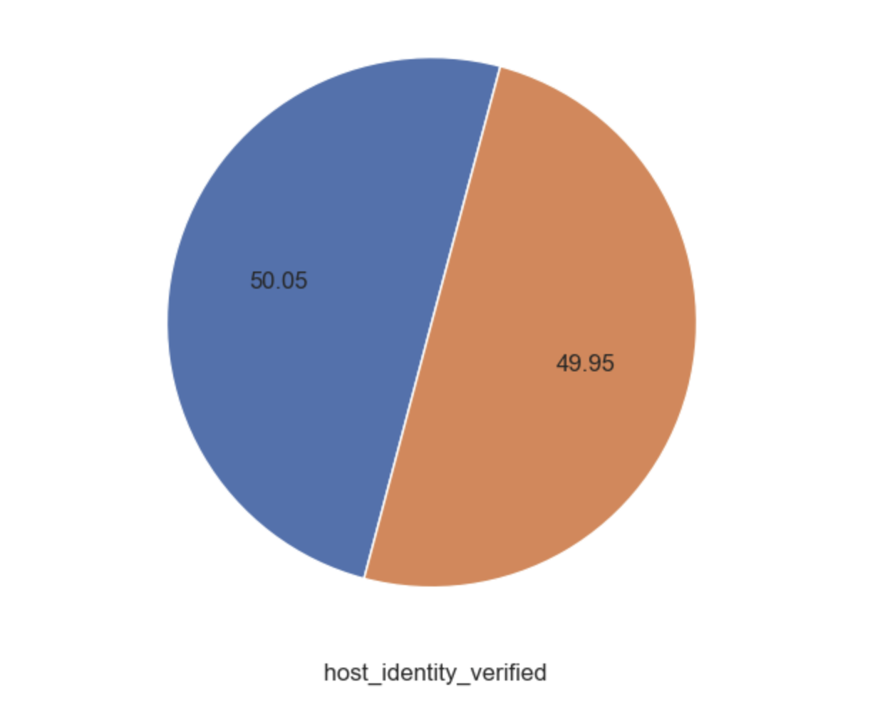
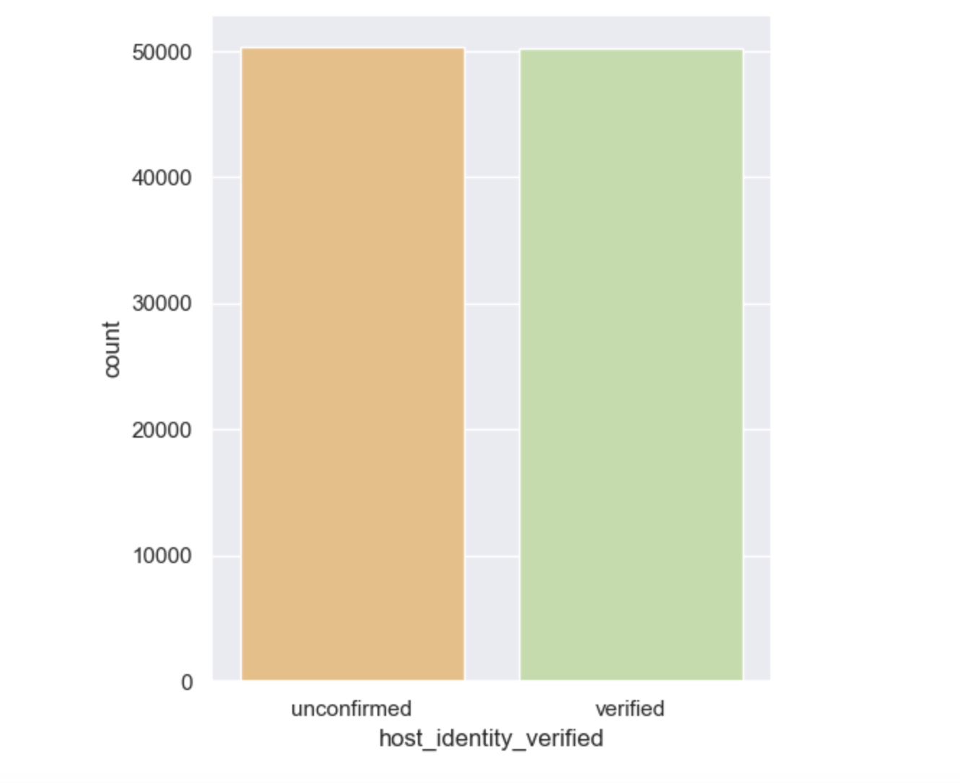
Exploratory Data Analysis
Bar plot and pie plot to illustrate the ratio of unconfirmed and confirmed host identity verificaitons.
Here we can see that hosts with unconfirmed identity are more in number.

Slide 6
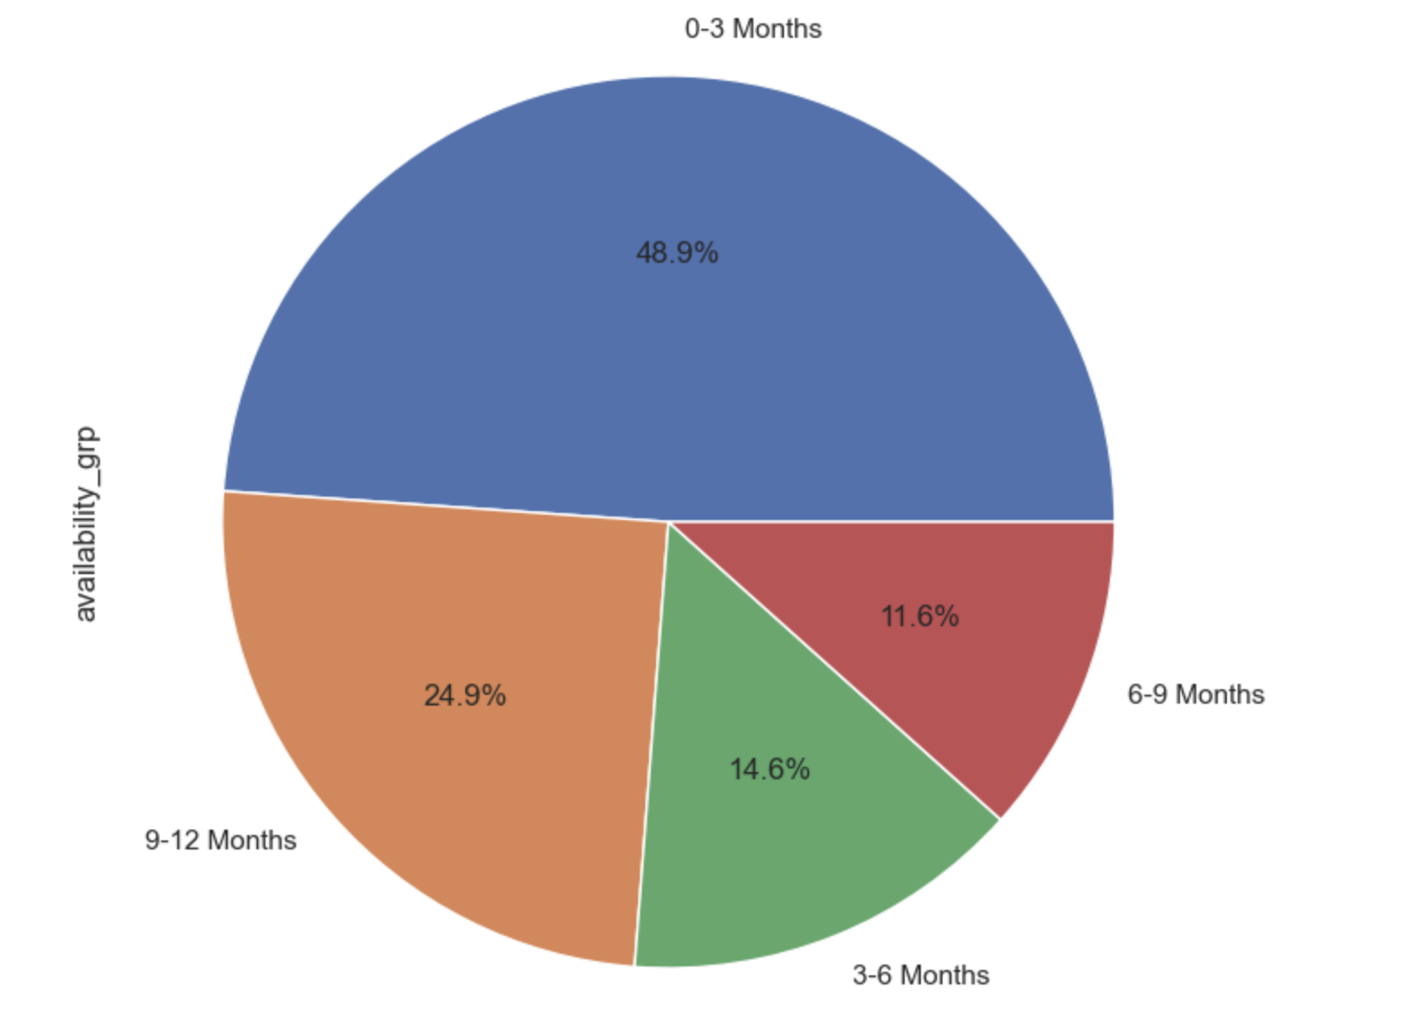
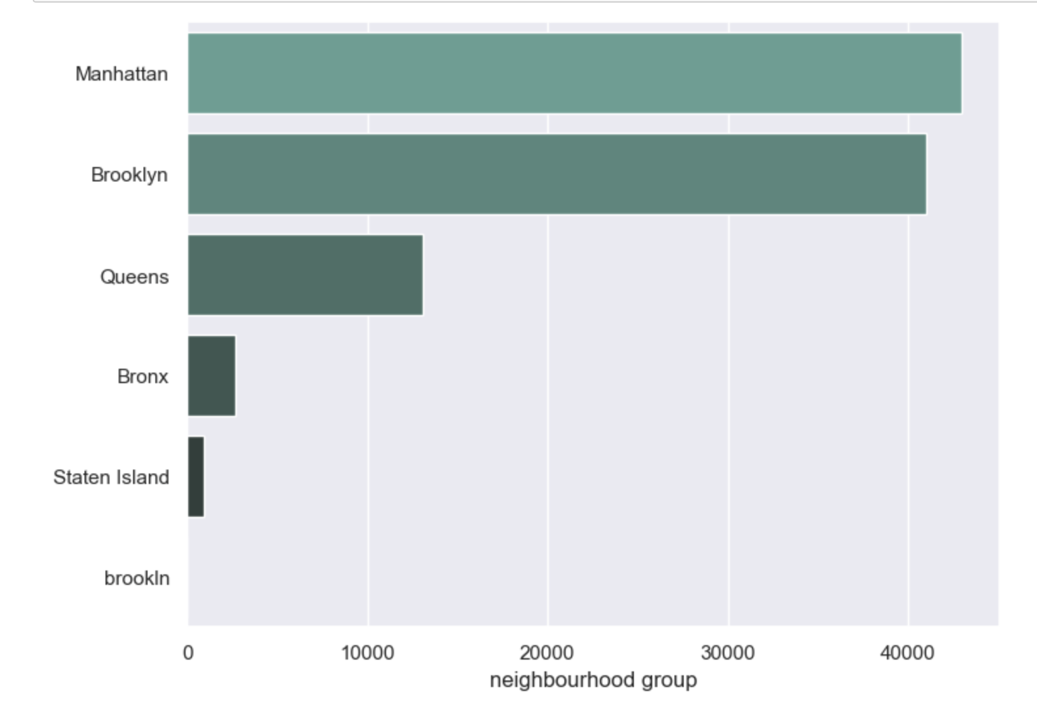
This plot illustrates that Manhattan has the highest number of neighbourhood groups in the entire data.
This plot illustrates that the most available groups are from 0 to 3 months.

Slide 7
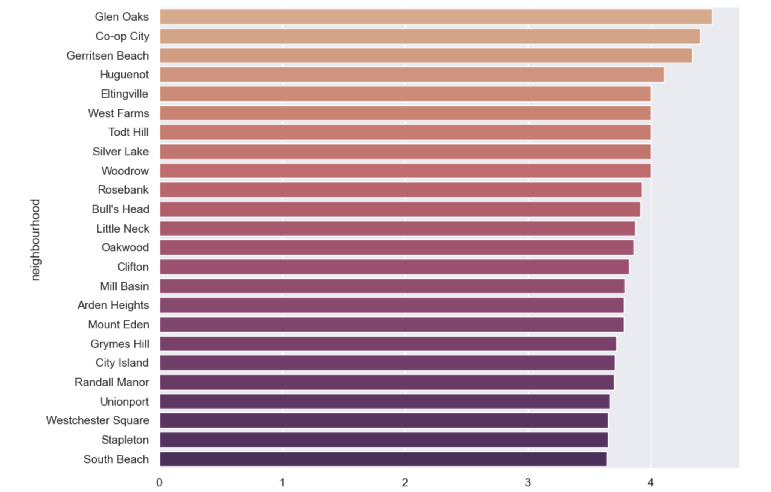
This graph gives an insight that “Glen Oaks” has the highest number of listings in the neigbhourhood.
Where, “south beach” has the lowest count.

Slide 8
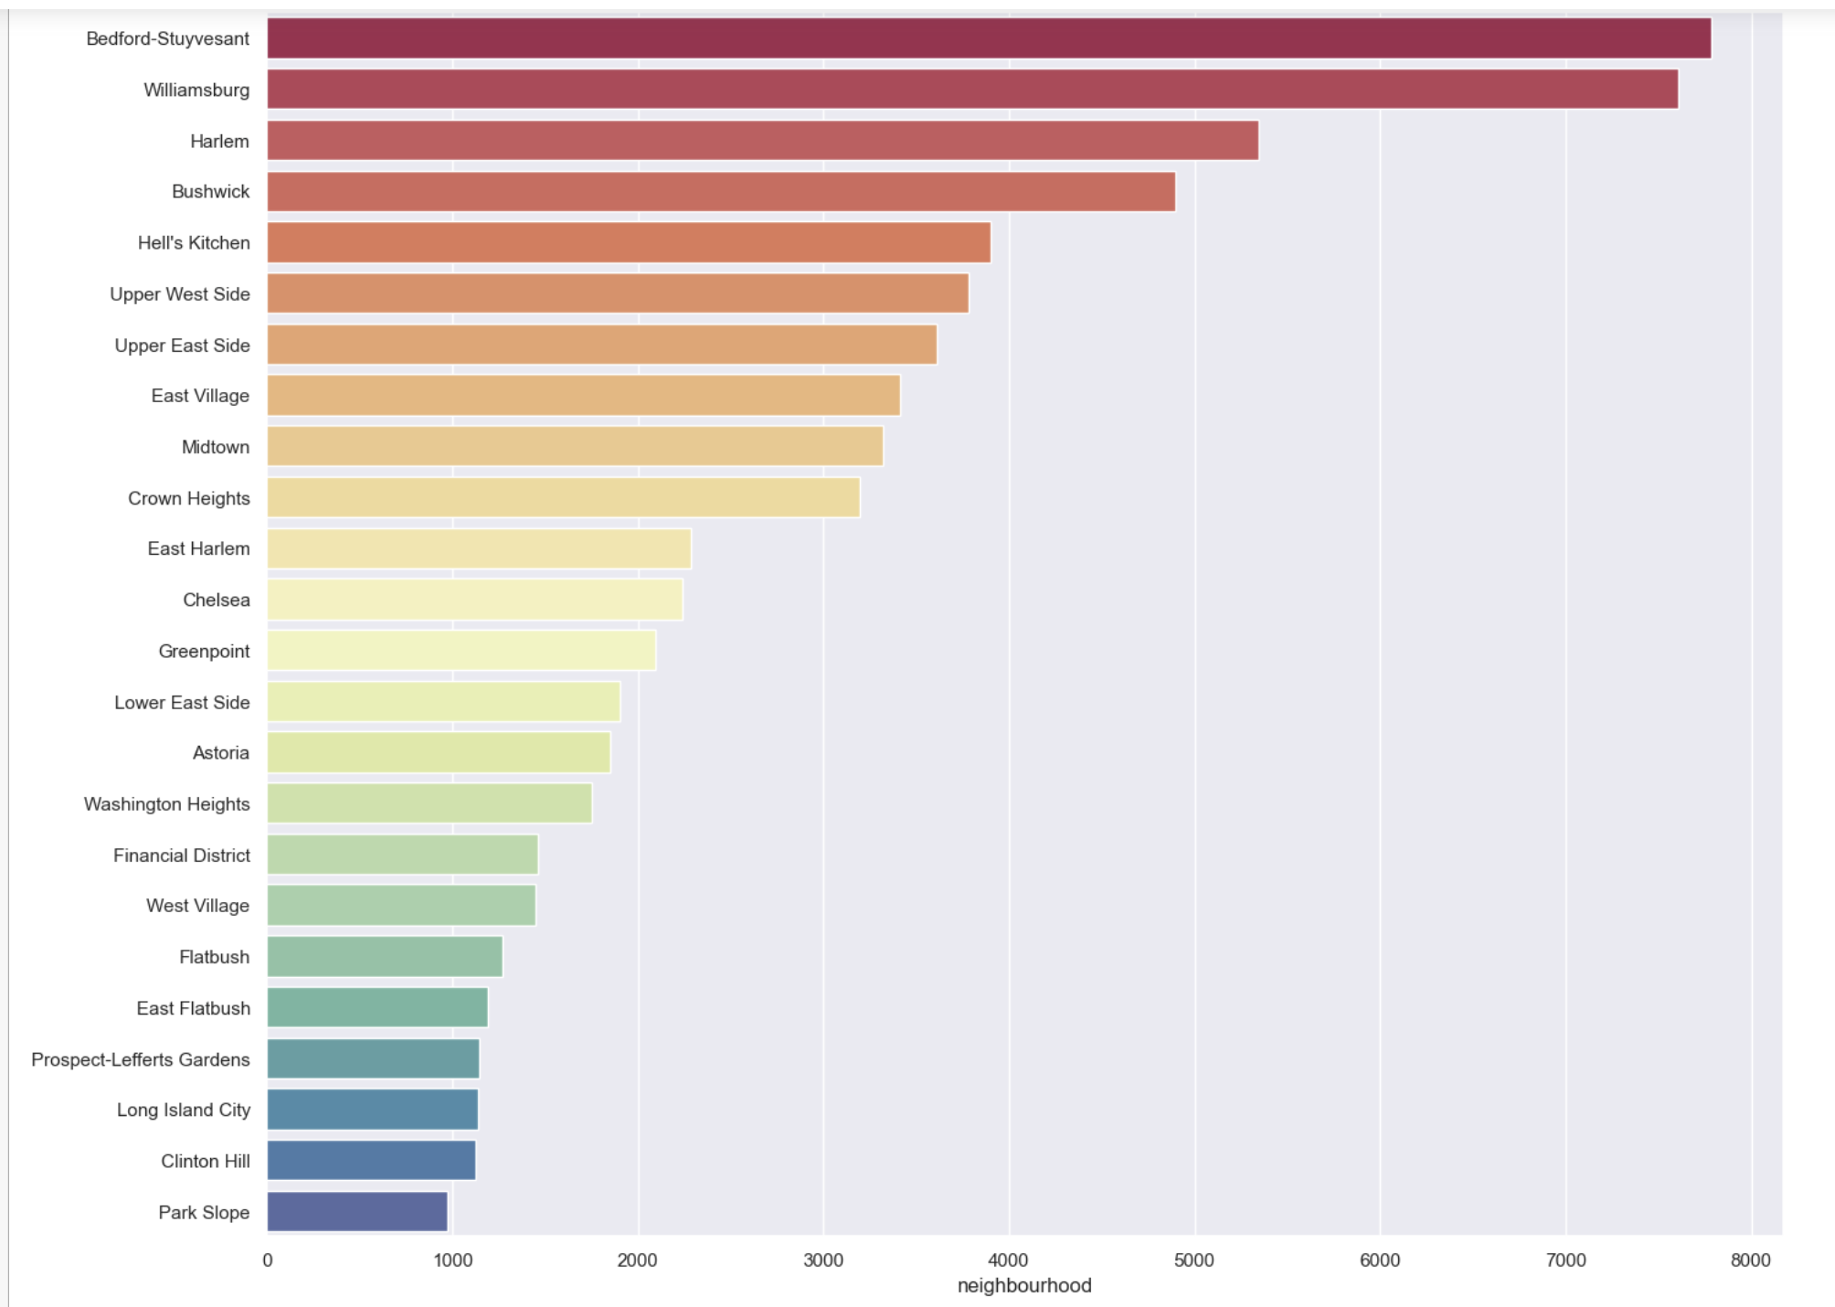
The above chat shows that more than 7700 listings are registered in “Bedford-Stuyvesant”.

Slide 9
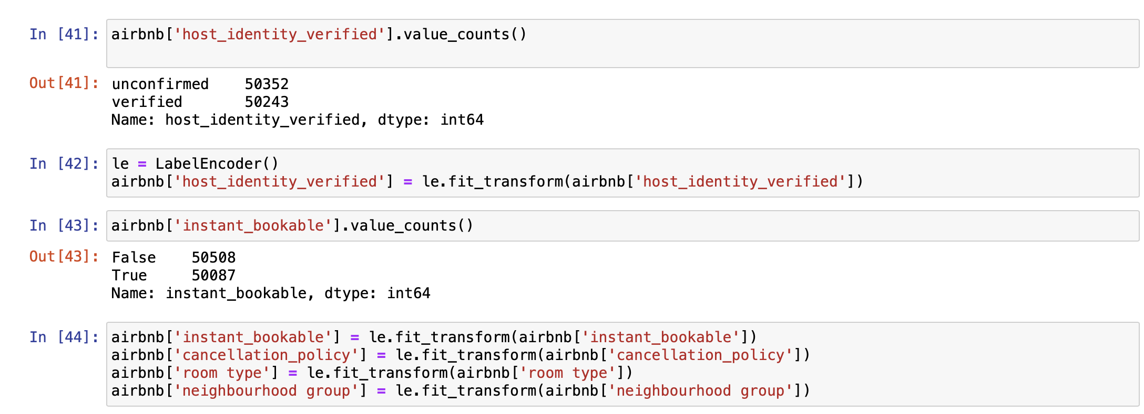
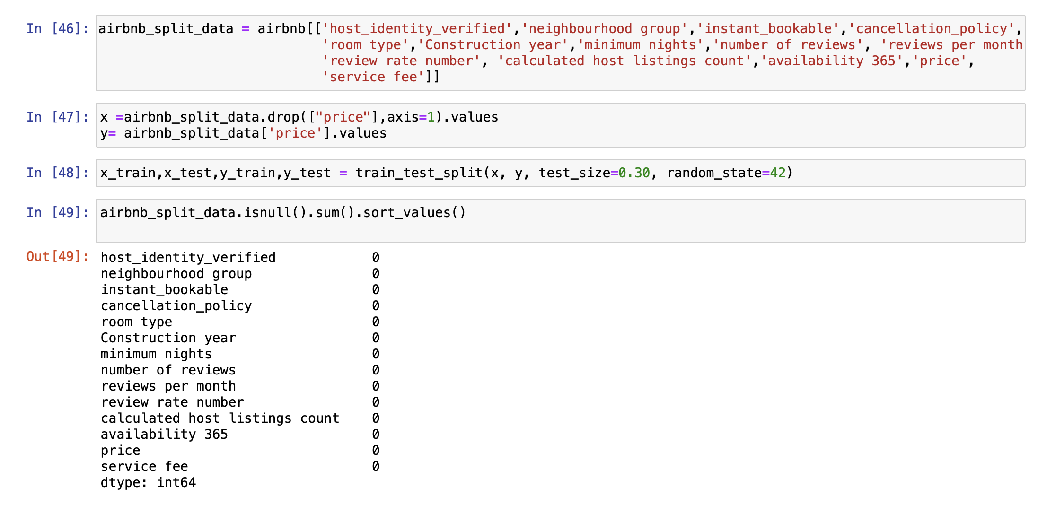
Encoding and Splitting data
This code is responsible for label encoding the object type features into integer type.
Here, we are selecting required features and splitting the data into training and testing samples.

Slide 10
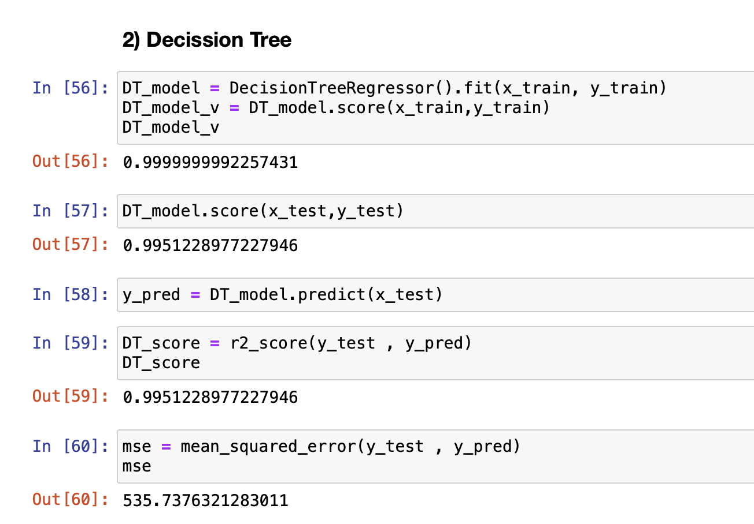
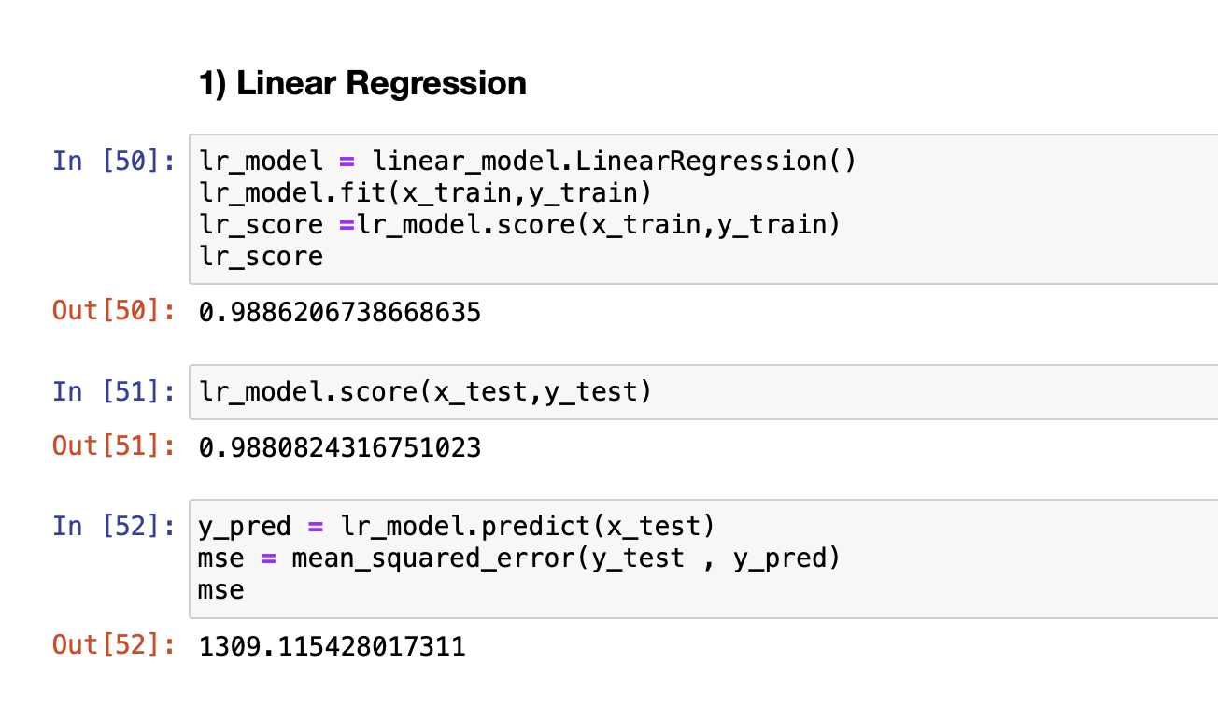
Modelling
Here we trained Linear regression model which is giving us an accuracy of 98.8%.
Here we trained Decision tree model which is giving us an accuracy of 99.5%.

Slide 11
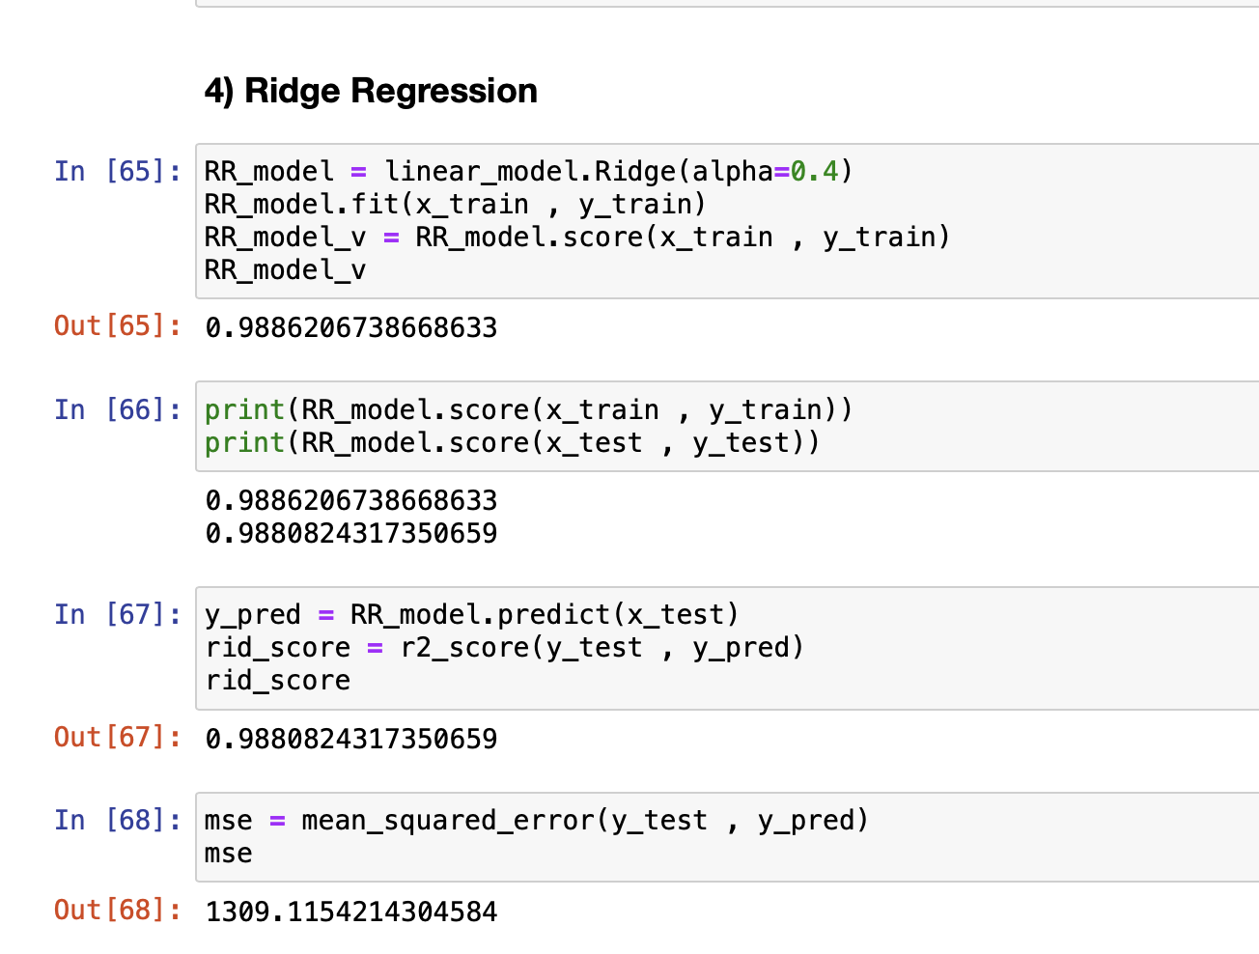
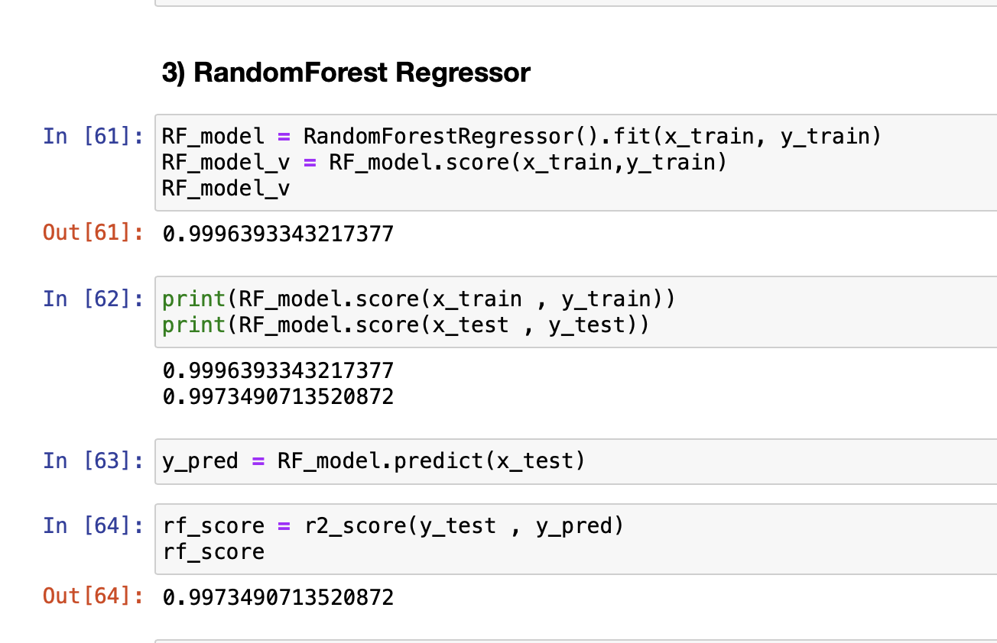
Here we trained a Random Forest Regressor which is giving us an accuracy of 99.7%.
Here we trained a Ridge Regressor which is giving us an accuracy of 98.8%.

Slide 12
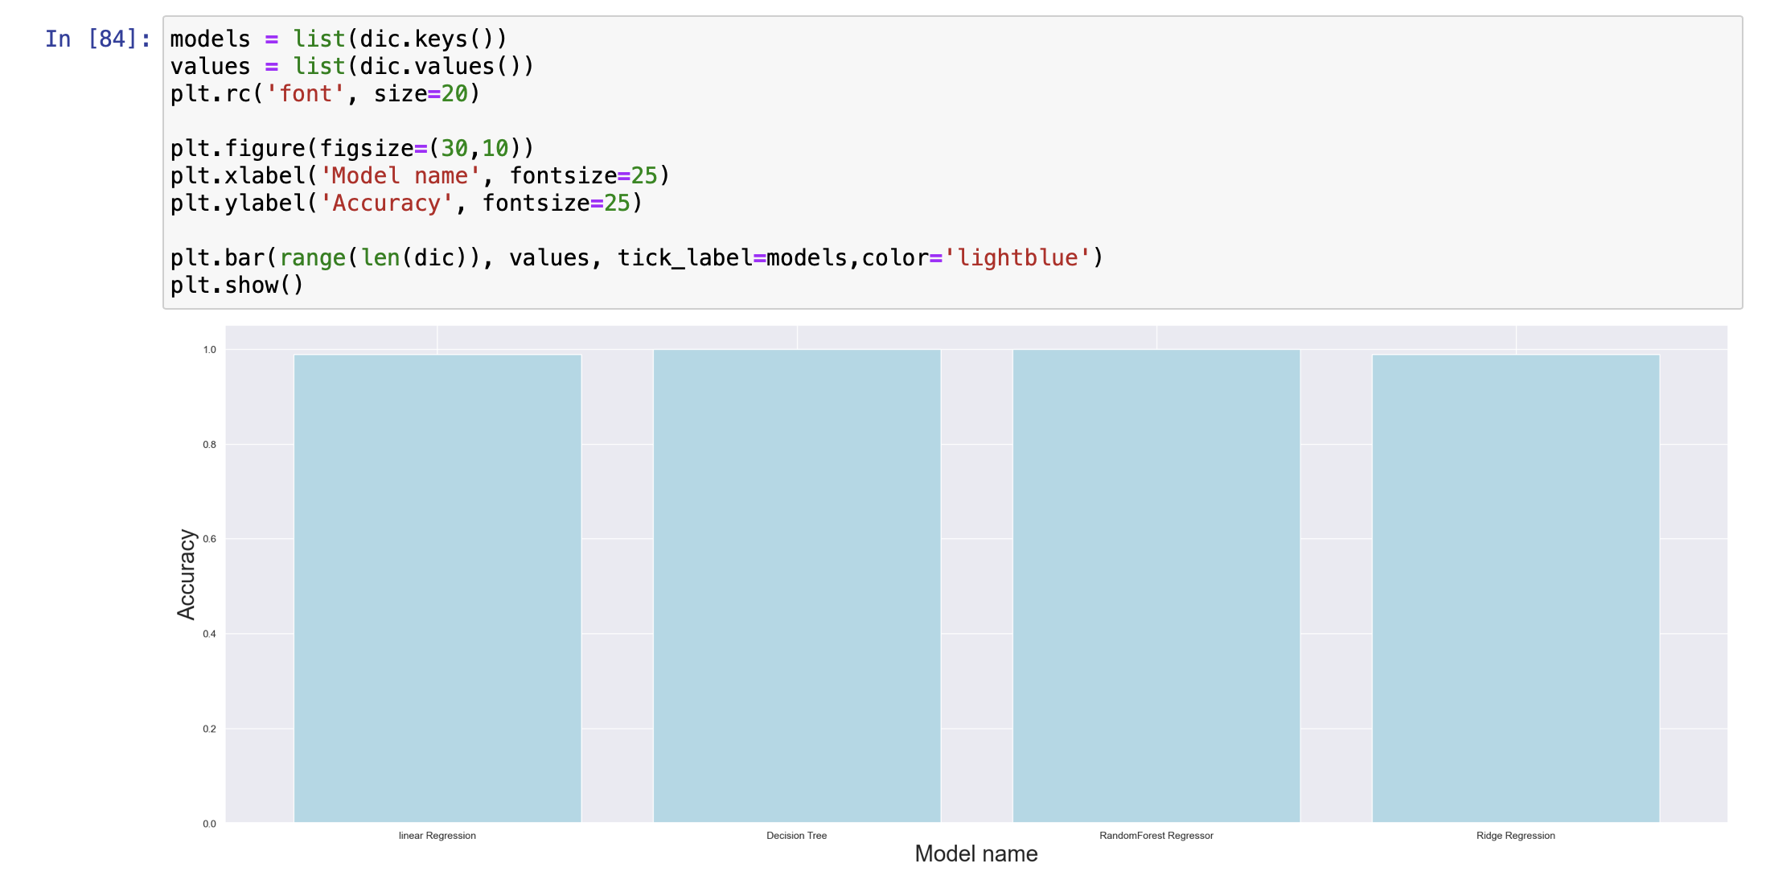
Model Accuracy report for all the mentioned algorithms.

Slide 13
Conclusion & Learnings
This project helps in visualizing the trends of Aribnb features based on various parameters which gives us a clear picture of the dataset.
“Random Forest Regressor” Model has given an Accuracy of 99.7% for the test data predictions of the “Price” which is the highest among our tests.
While working on this project, I understood that feature engineering and feature selection are one of the most important steps in order to train the predictive models which result in highest accuracies.
With the help of this project, I have learned to utilize different python libraries and use them to handle huge data and getting insights from it.

Slide 14
THANK YOU

